Slide 1
STUDY OF SEGREGATION OF NON-SPHERICAL PARTICLES USING DEM IN A VIBRATING PACKED BED
Nishant Singh Sikarwar
Department of Chemical Engineering
IIT Roorkee
Under the guidance of
Dr. Anshu Anand

Slide 2
PROJECT OUTLINE
Introduction
Our Project, Problem Statement
Models
Granular Contact Models
Features and Coding Concepts
Liggghts, MPI, Discrete Element Method (DEM)

Slide 3
INTRODUCTION (PROJECT OVERVIEW)
Simulate Vibrating Packed Bed Filled with non-spherical particles.
Analyze the segregation of mixture in the bed.
Use Discrete Element Method (DEM)

Slide 4
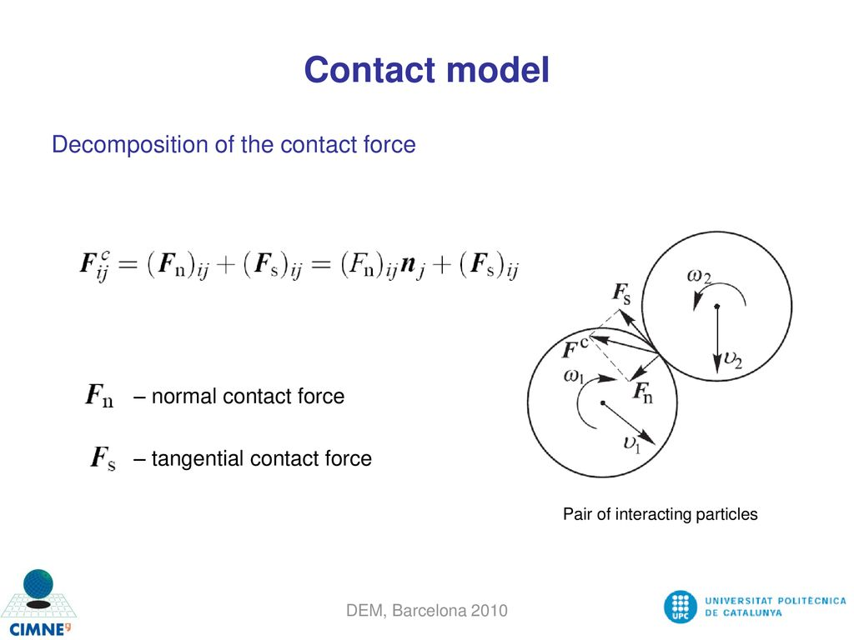
MODELS (GRANULAR CONTACT MODELS)

Slide 5
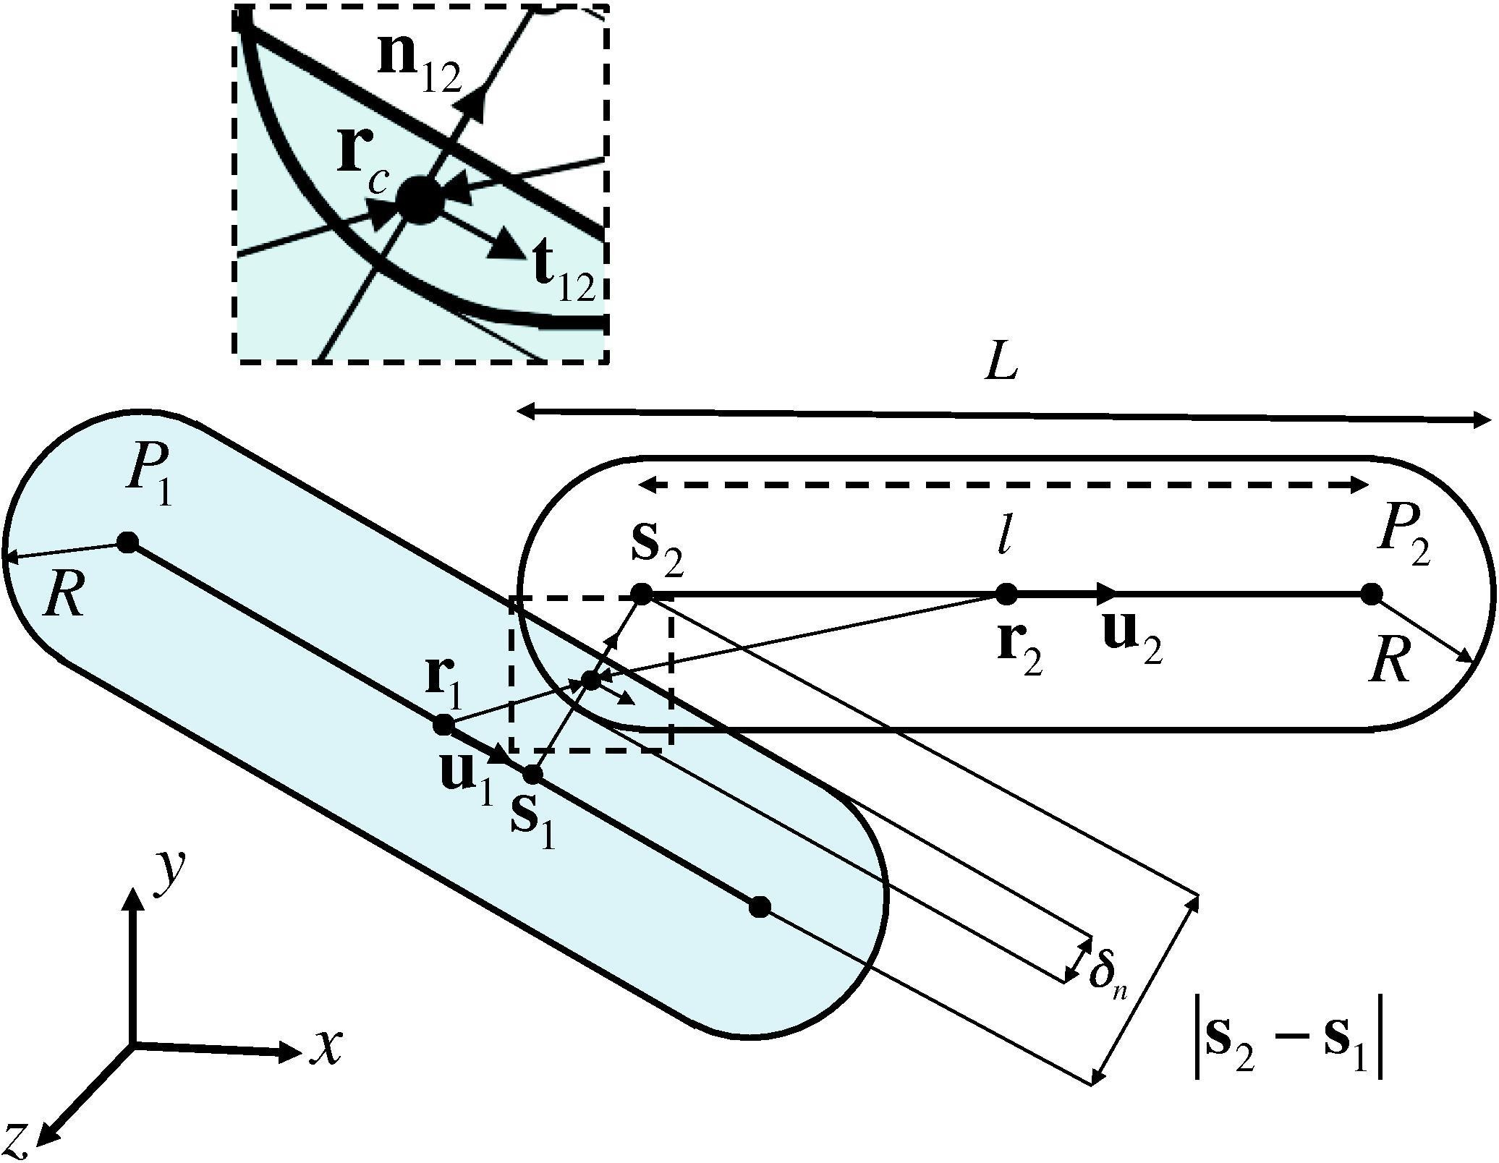
LIGGGHTS MODEL

Slide 6
LIGGGHTS (OVERVIEW)
LAMMPS IMPROVED FOR GENERAL GRANULAR AND GRANULAR HEAT TRANSFER SIMULATIONS
LIGGGHTS = An Open Source, C++, MPI parallel DEM code

Slide 7
SIMULATION OF VIBRATING BED
Create a mesh or define a boundary (Declare domain)
Initialize the material and its properties
Insert particles
Define the physics or contact models
Define the timestep

Slide 8
PROTOTYPE OF VIBRATING PACKED BED
VVibrain
(15 Hz) (30 Hz)

Slide 9
FUTURE GOALS
Do a quantitative analyses of segregation of the mixture of non-spherical particles
Compare the simulation results with experimental for modelling the mixture.

Slide 10
THANK YOU

